Slide 1


Localization of Mobile Victims During Disaster Scenarios

Slide 2
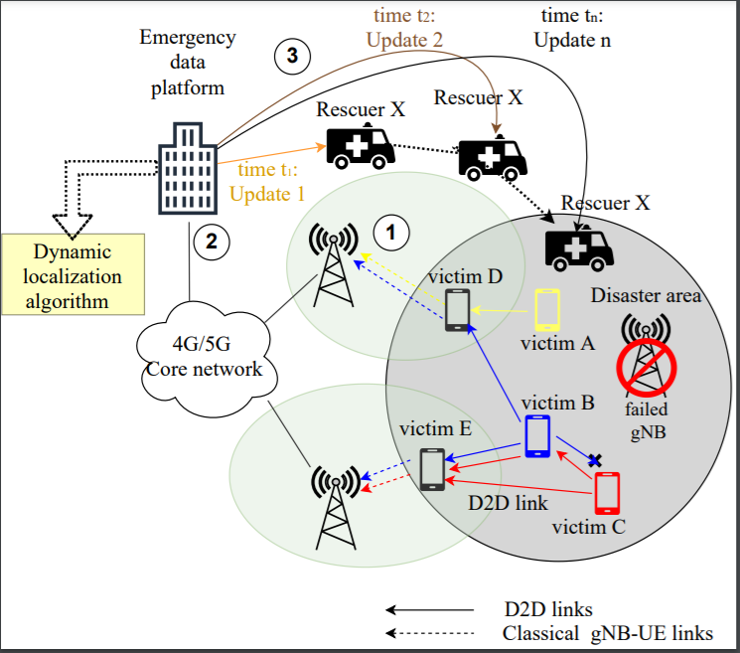
How to find the location of mobile victims?

Slide 3
Localizing multiple victims in out of coverage areas using multi-hop calls and dynamic constraint satisfaction (DCS) methods
Notes:
Goal

Slide 4
Emergency platform localization system
B. Mobile Multi-victim localization algorithm
Multi-Hop Calls
Constraint Optimization
Nonlinear constraints based problem
Successive Linear Programming (SLP)
Emergency Call Center
Simulated annealing
Update Localization results after fixed interval
Emergency Data Platform
A. Initialization
Priority based ordering
Constraint Generation for New Data
Multi-hop Call Data Extraction (GPS, RSSI, TOA, AOA)
Dynamic Localization Mode selection
MVLA_recent
MVLA_seq
MVLA_all
Notes:
Update multi victim block if necessary

Slide 5


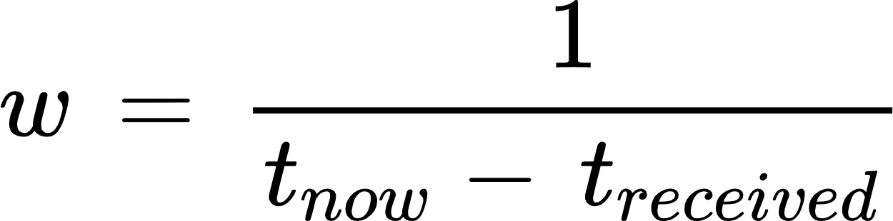
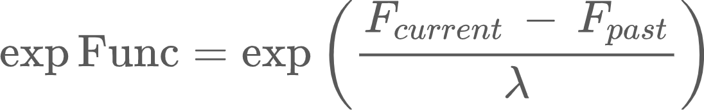
Constraint optimization using simulated annealing
Input data: Initial solution set, , learning rate( ), F_{past}
While ( > threshold)
{ For each node compute a weight based on the freshness of received data
Localizing devices using the constraint set
Selecting the non satisfied constraints
Compute
If (F_{current}>0)
If ( ): Break
Update the estimated solution with a new random solution}
Output: set of solutions of location of nodes per each update

